Slide 1
Project Night terror
Evan Geissler
Notes:
**Randomly generate where texts are, items are, placements, etc. Core static, other stuff different.

Slide 2
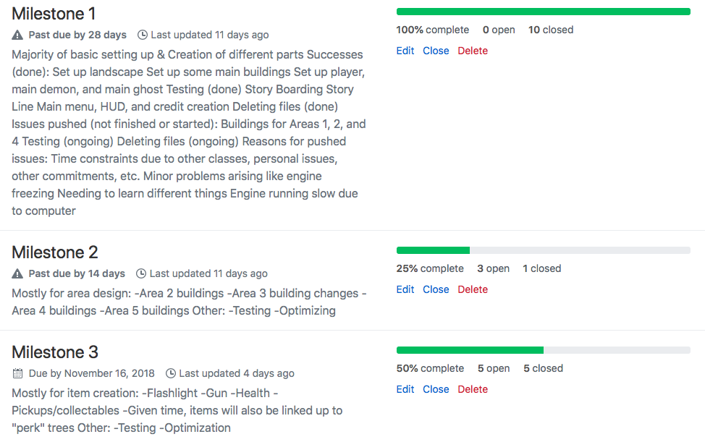
Milestones

Slide 3
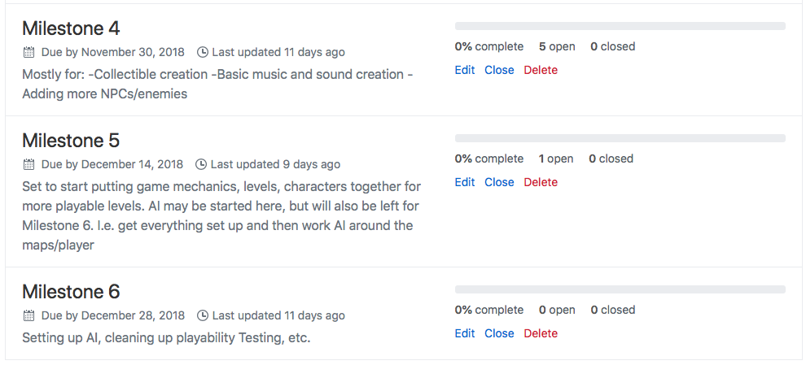
Milestones

Slide 4
Milestone 2
Oct. 19th to Nov. 2nd

Slide 5
focus
1) Different Area Buildings
2) Deleting unused content/start content
3) Update Documentation
4) Collectables
5) User Interfaces & Menus

Slide 6
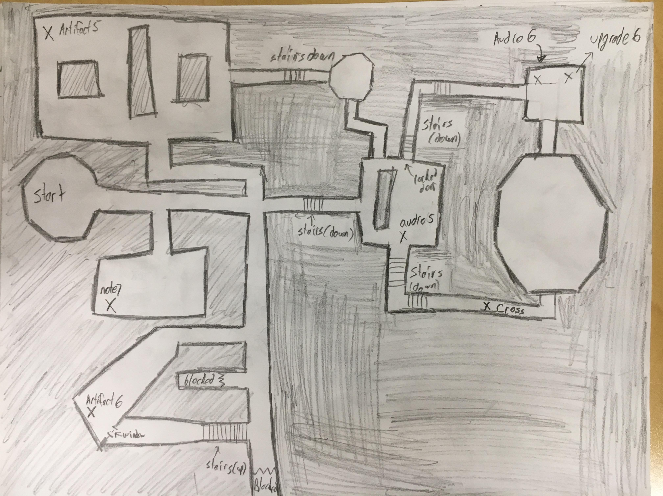
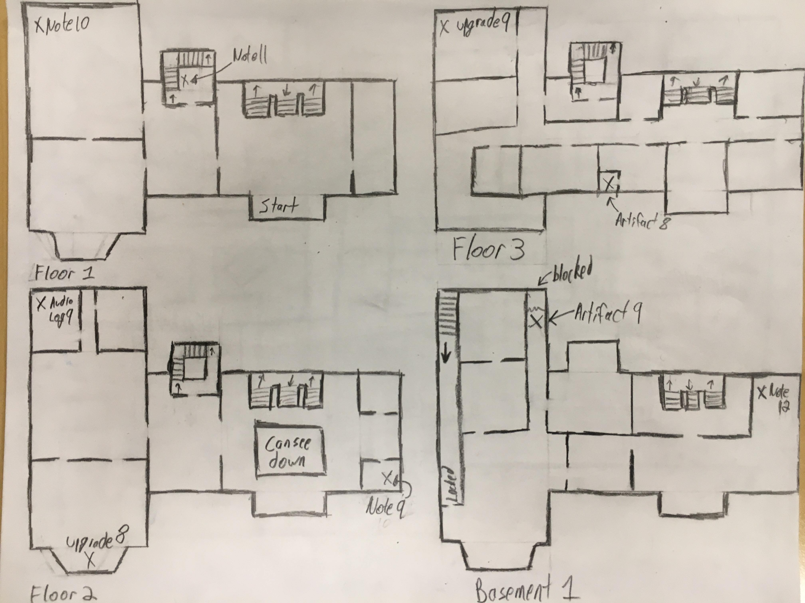
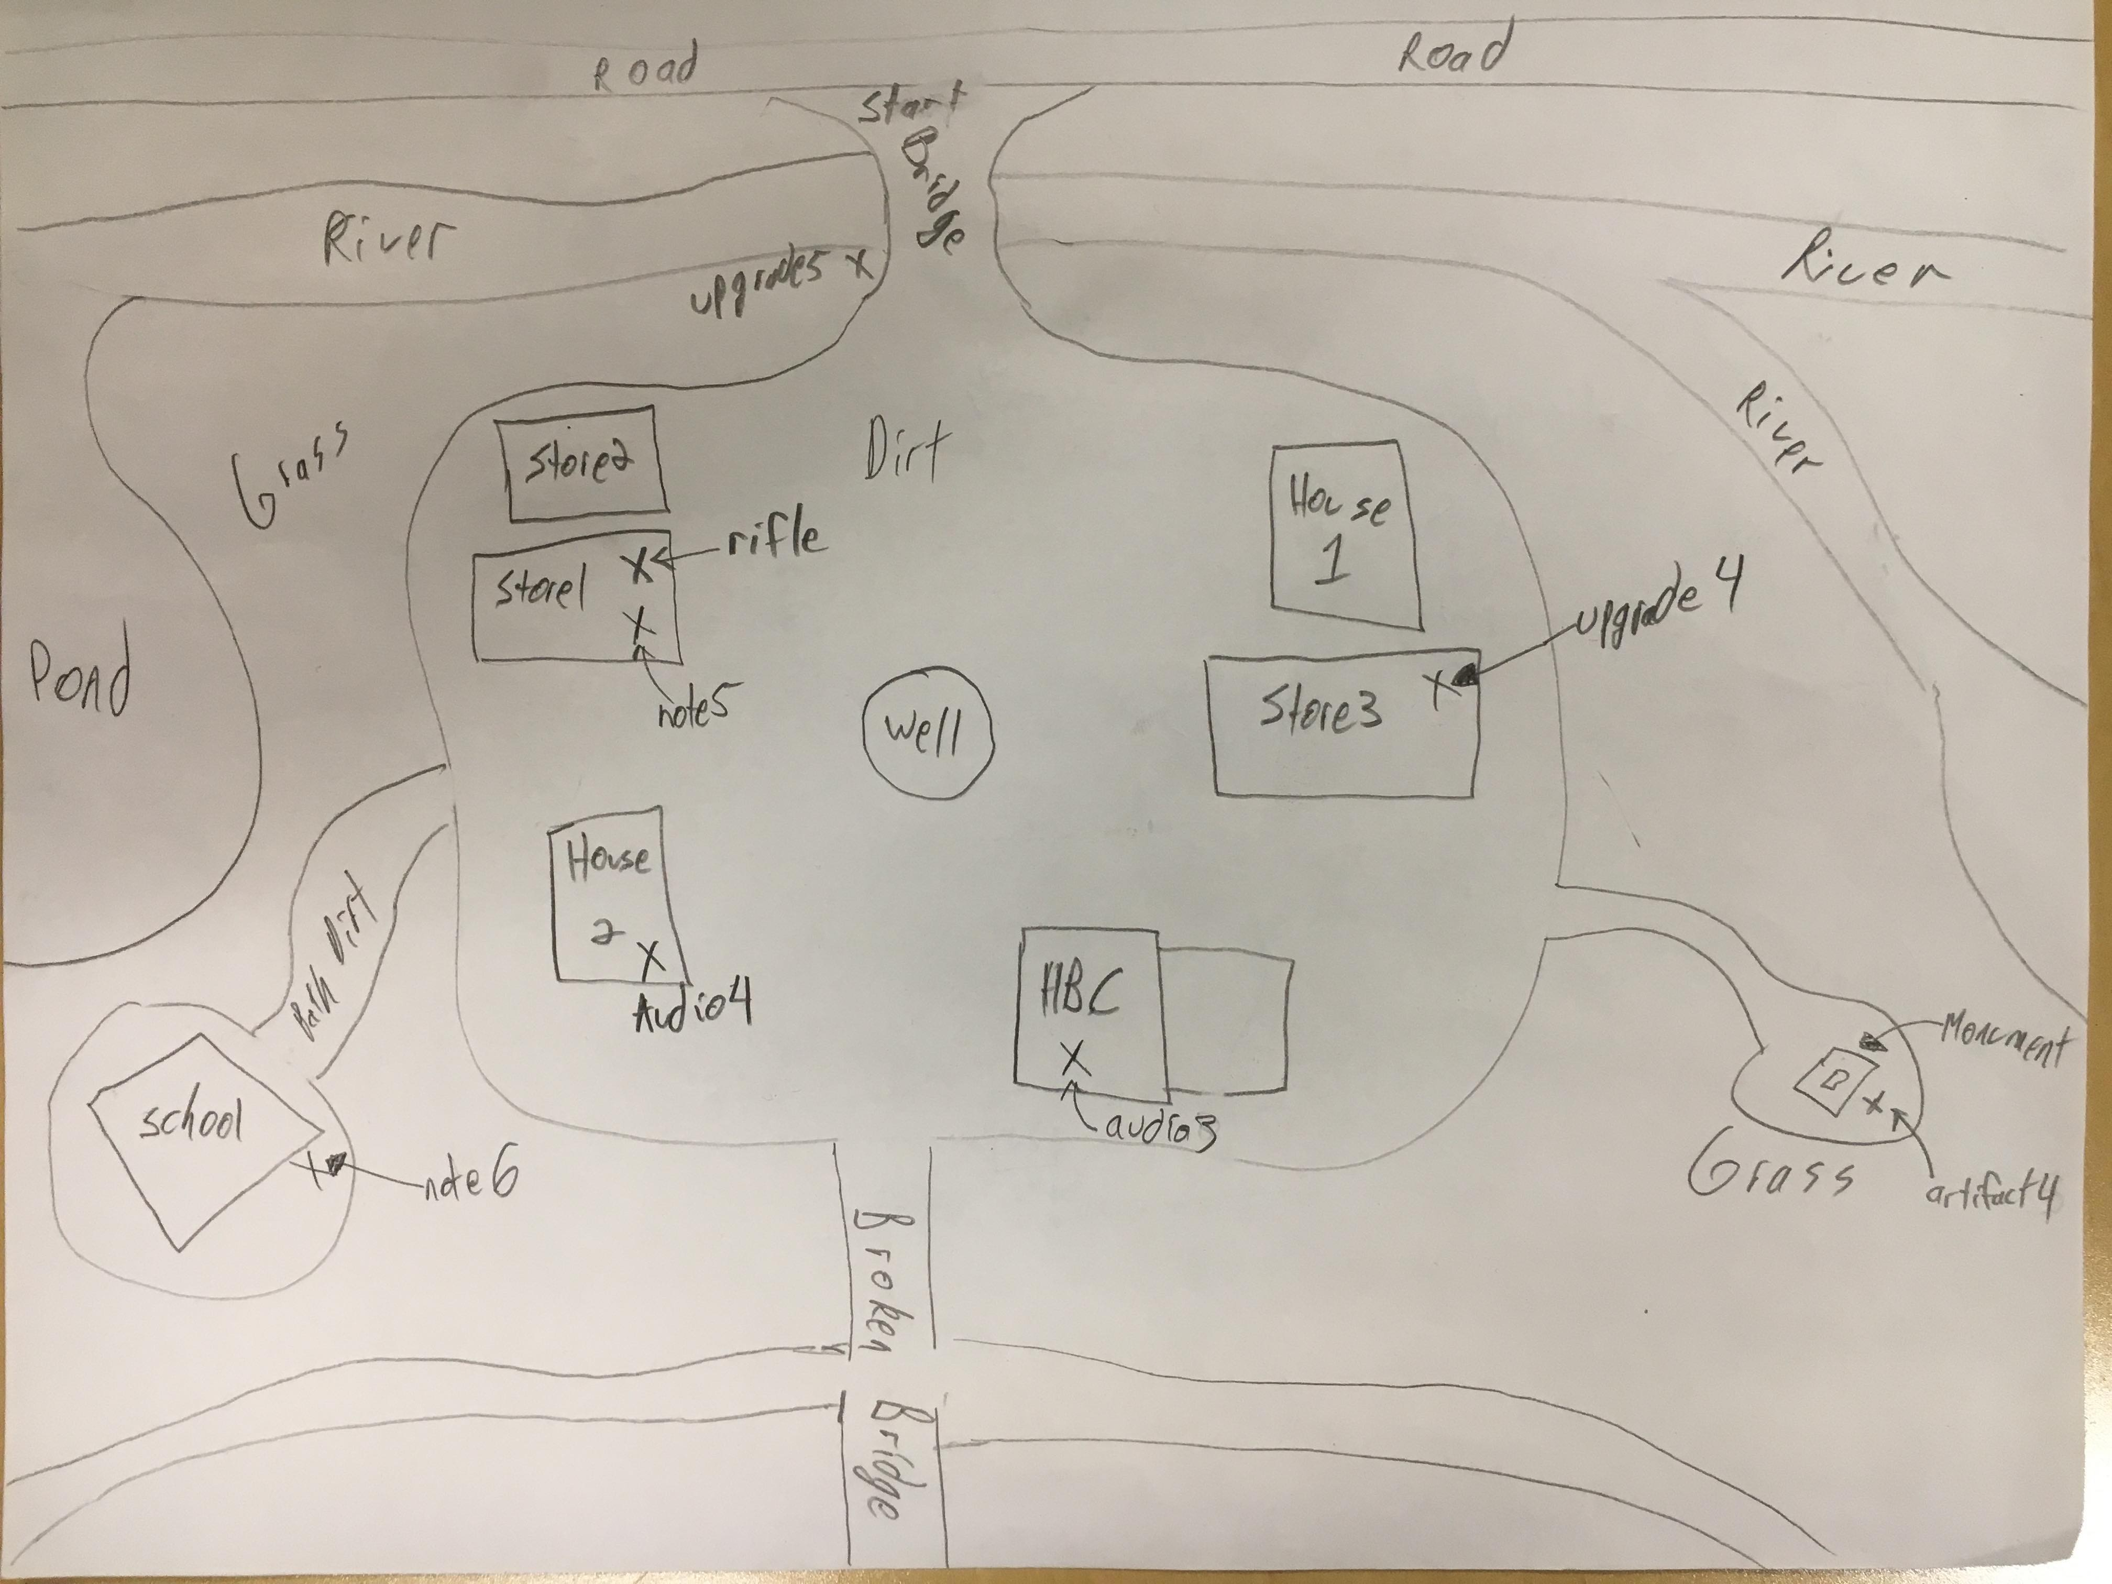
Maps & Locations

Slide 7
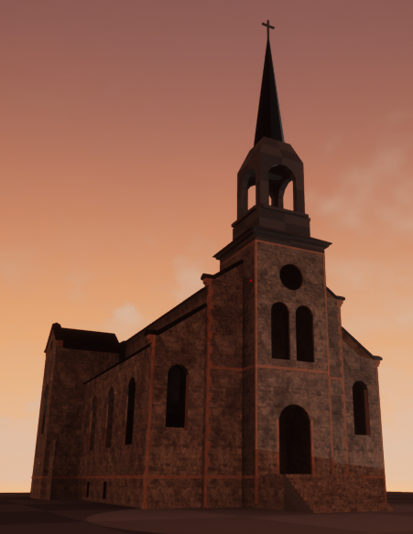
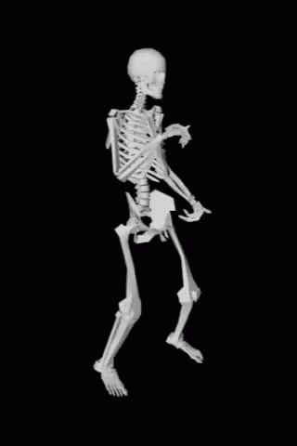
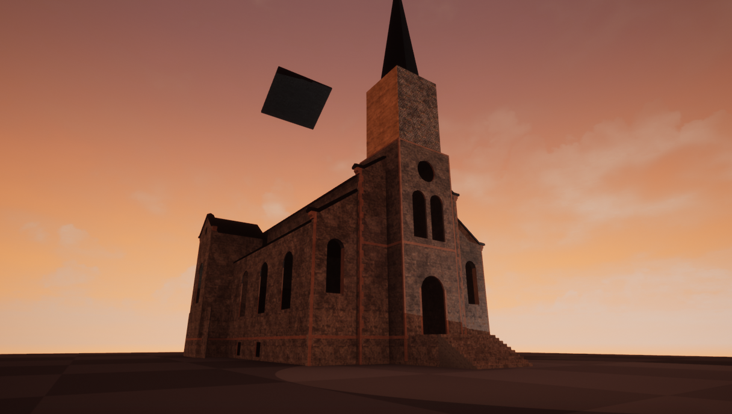
Area Buildings
Lebret- Sacred Heart Church
Church Created in Game

Slide 8
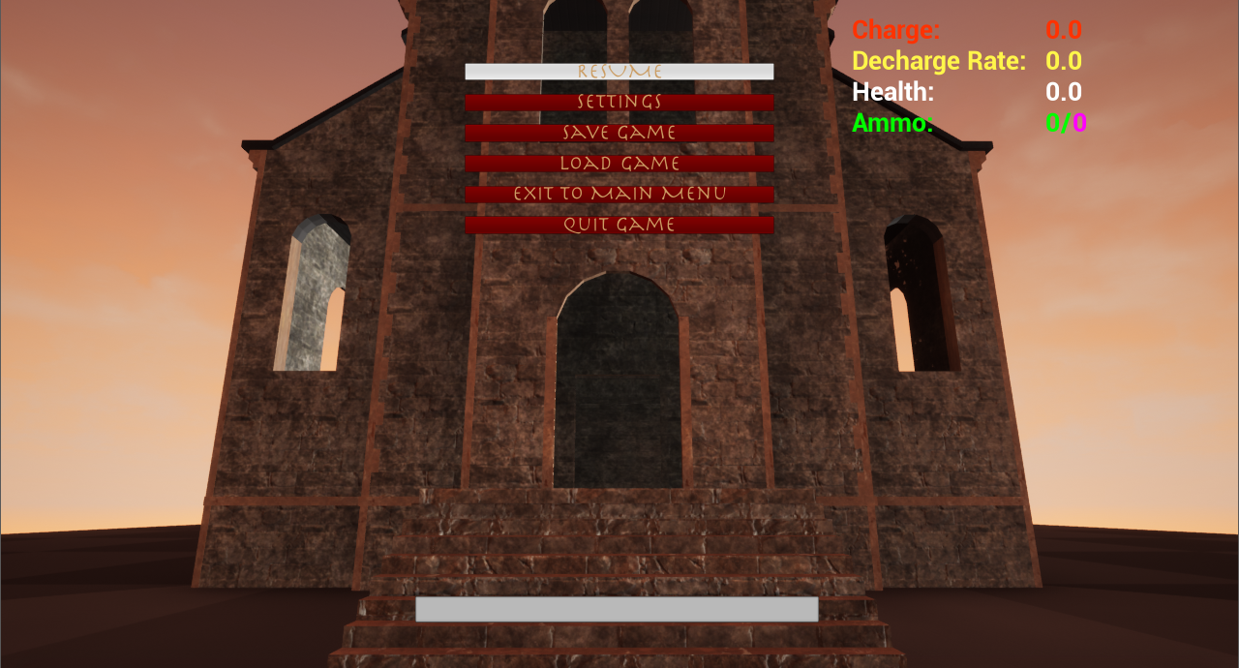
Menus/Updated HUD
Pause Menu

